Slide 1
Increasing Profits Through Demand Forecasting
Using Seoul Bike Sharing Demand Data
Benjamin Baugh

Slide 2
Introduction of Business Case
GOAL
Our goal is to predict the hourly demand of bike rentals. With this information, we can make sure the correct number of bikes are available for customers to rent. We want to avoid stock outs to maximize revenue. We can also eliminate waste and the cost associated with having too many bikes.
PROCESS
We will clean and prepare the data and try many regression algorithms. After we find the model best suited to our task, we will fine-tune it. Finally, we will test the model with new data.
RESULTS
The results indicate that after fine-tuning, the XGBoost model was the most accurate. Looking at an Actual vs Predicted plot, we see the model is more accurate when demand is between 0 and about 1300. When demand goes over 1500 then the model is less accurate. That being said, the hourly demand stays below 1500 most of the time.

Slide 3
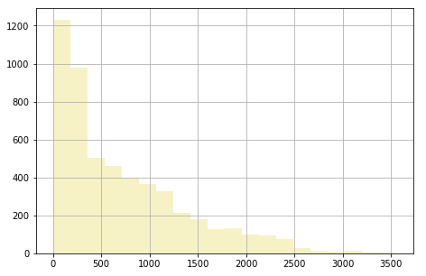
Data Description
There are 13 independent variables. Our dependent variable is Rented Bike Count. There are three columns that are not numeric and will need to be prepared before modeling. There are no missing values in any columns.
The number of bikes rented has a Poisson distribution. Temperature & Humidity are close to a normal distribution. Wind speed, Visibility (10m), Solar Radiation, Rainfall and Snowfall have either a floor or a ceiling.
Distribution of Bikes Rented
Variables
Date: year-month-day
Rented Bike count: Count of bikes rented at each hour
Hour: Hour of the day
Temperature: Temperature in Celsius
Humidity - %
Windspeed - m/s
Visibility - 10m
Dew point temperature: Celsius
Solar radiation - MJ/m2
Rainfall - mm
Snowfall - cm
Seasons: Winter, Spring, Summer, Autumn
Holiday: Holiday/No holiday
Functional Day: NoFunc(Non Functional Hours), Fun(Functional hours)

Slide 4
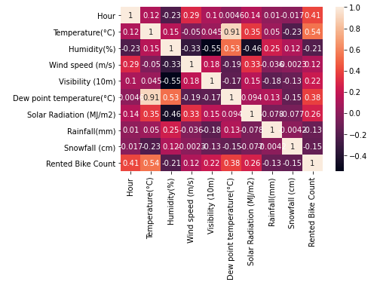
Correlation
After creating a correlation matrix, we see “Temperature” and “Dew point temperature” are highly correlated.
We want to avoid multicollinearity so we will drop one of the variables.
We will keep “Temperature” because it has a higher correlation with Rented Bike Count.
Correlation Matrix

Slide 5
Cleaning and Preparing the Data
Turned “Seasons”, “Holiday”, and “Functioning Day” into dummy variables.
Broke out the date column into 5 variations of date:
Year
Month
Day of Month
Week Day
Day of Week.
Dropped variable “Dew point temperature”
Scaled the variables with a min max scaler

Slide 6
Shortlist Promising Model
Test some models to find which algorithm has the most promise with our data. Models tried:
Linear Regression
Decision Tree
Random Forest
Support Vector Machine (SVM)
XGBoost
The metrics used to compare models were:
Mean Absolute Error (MAE)
Mean Squared Error (MSE)
Root Means Squared Error (RMSE)
R Squared
Put the most weight behind the RMSE metric

Slide 7
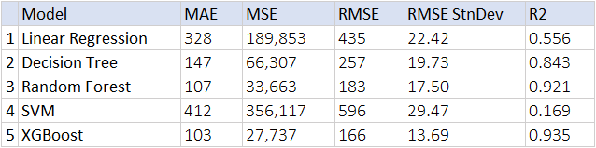
Results of Shortlisting
Used Cross Validation with 10 folds. We took an average of the metrics for each model and a standard deviation of RMSE.
Looking at the results the Random Forest and XGBoost models were the most accurate.

Slide 8
Fine-Tune the Models
Tuned both the XGBoost and Random Forest models.
Used cross-validation and grid search to find the best set of hyperparameters.
RMSE was used as the metric to re-fit for testing
After running many versions of both models the XGBoost model was the most accurate
The best hyperparameters were "max_depth=10,n_estimators=1000".

Slide 9

Conclusion
Our goal at the onset of the projects was to predict the hourly demand of bike rentals.
With an accurate prediction we could increase profitability.
After finding the best model and fine-tuning it, we tested the model on a new set of data. At the beginning of our projects we split out a test data set that was 20% of the total data.
The results were the best yet as measured by our selected metrics.

Slide 10
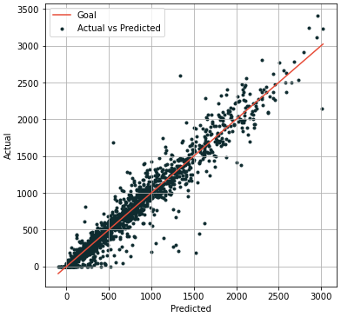
Graph of Results
This Actual vs Predicted graph shows the clustering around the red line which was our goal.
We see the clustering around the line becoming looser when it passes approximately 1500.

Slide 11
Code
The Code For This Project Can Be Found At This Link

